Slide 1

Statistical Methods in Six Sigma (MDM31235)
Prof. Shreenivas Londhe Ph.D. P. D. F.
shreenivas.londhe@viit.ac.in
Dr. Preeti Kulkarni
preeti.Kulkarni@viit.ac.in
Department of Civil Engineering
BRACT’S, Vishwakarma Institute of Technology, Pune
(An Autonomous Institute affiliated to Savitribai Phule Pune University)
(NBA and NAAC accredited, ISO 9001:2015 certified)

Slide 2
Review of previous session
Nil
Prof. Shreenivas Londhe and Dr. Preeti Kulkarni, Department of Civil Engineering, VIIT , Pune-48
Faculty Name(optional), Department of ______Engineering, VIIT, Pune-48

Slide 3
Objective/s of this session
Discuss concept of quality, Total Quality Management (TQM
Understand concept of quality, Total Quality Management (TQM
Discuss history and principles of Quality
Learning Outcome/Course Outcome
Prof. Shreenivas Londhe, Department of Civil Engineering, VIIT , Pune-48

Slide 4
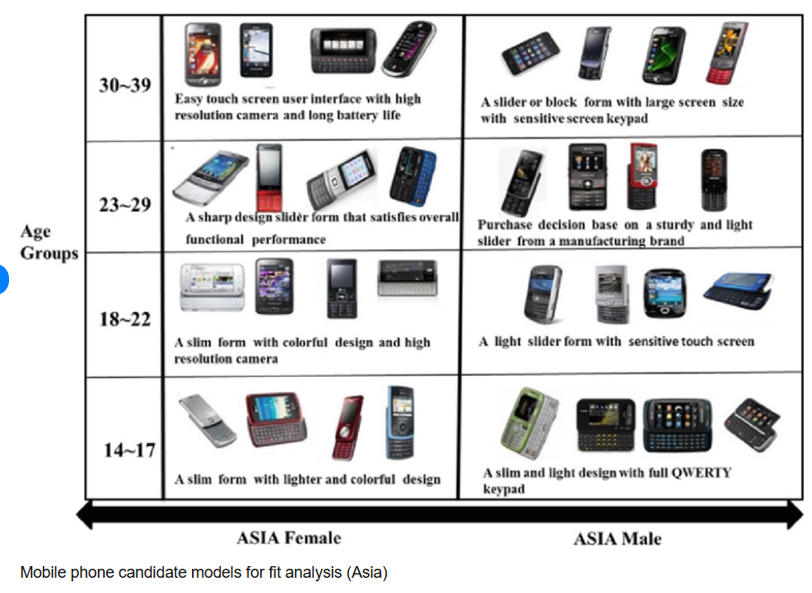



Quality – Let’s mull over a bit
Based on Speed,
Battery Life
Camera
Price
Weight
Display
PWM(Pulse Width Modulation)
Dynamic Island
Specs
Rating etc.
Ref: Kremer, Gül & Chiu, Ming-Chuan & Kim, Tae-Hyun. (2013). Perceived feature utility-based product family design: A mobile phone case study. Journal of Intelligent Manufacturing. 24. 10.1007/s10845-012-0699-5.
https://www.youtube.com/watch?v=_SO_3ZJgahE
https://www.youtube.com/watch?v=XYo0VbxloN4
Prof. Shreenivas Londhe and Dr. Preeti Kulkarni, Department of Civil Engineering, VIIT , Pune-48

Slide 5




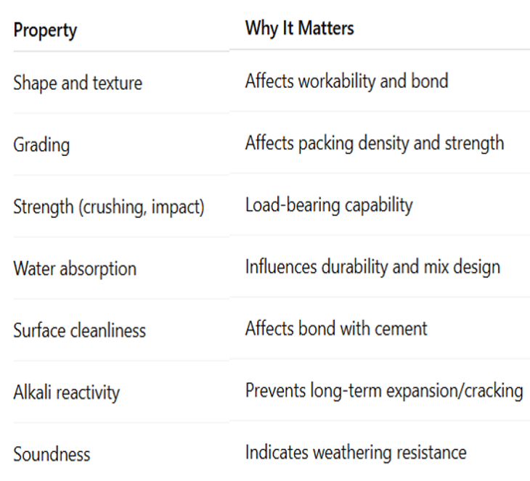
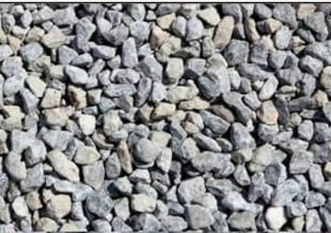

Quality – Lets mull over a bit
Source and Type of Rock
Particle Shape and Texture
Size and Grading
Strength and Toughness
Water Absorption and Porosity
Durability and Soundness
Specific Gravity
Alkali-Aggregate Reactivity (AAR)
Prof. Shreenivas Londhe and Dr. Preeti Kulkarni, Department of Civil Engineering, VIIT , Pune-48
Faculty Name(optional), Department of ______Engineering, VIIT, Pune-48

Slide 6
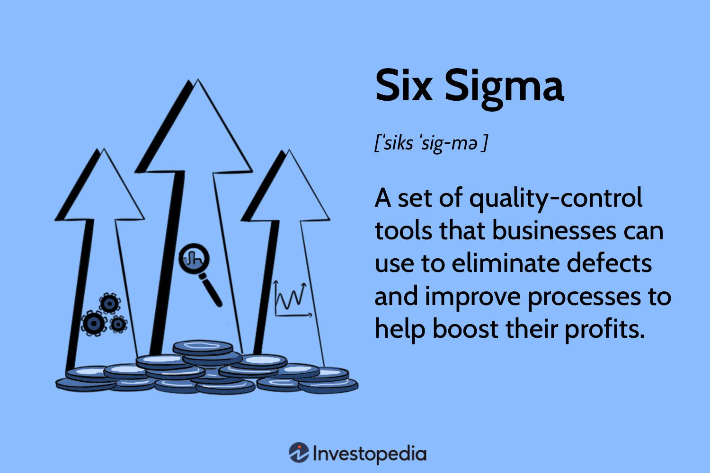
Quality – Definition and Concept
Quality refers to the degree to which a product, service, or process meets a specified set of requirements or expectations, often implying a level of excellence or fitness for purpose.
Quality is a measure of how well something (a product, service, or process) meets its intended purpose and satisfies customer needs and expectations.
Quality can be assessed based on various factors like performance, reliability, durability, features, aesthetics, and conformance to standards.
Quality is a relative term and used with reference to the
end-use of product.
Quality is aimed at the needs of the customer, present and
future.
Prof. Shreenivas Londhe and Dr. Preeti Kulkarni, Department of Civil Engineering, VIIT , Pune-48

Slide 7
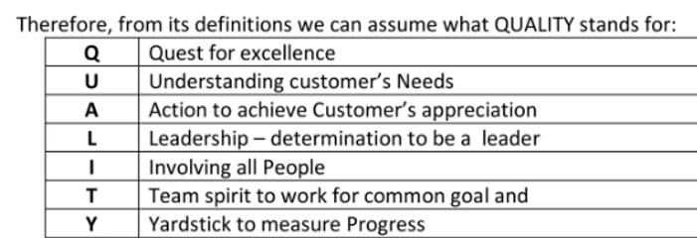
Quality – Definition and Concept
According to [ISO 9000:2015, 3.6.2] Quality is defined as the “degree to which a set of inherent characteristics of an object fulfils requirements”
Degree: Quality such as poor, good and excellent
Inherent: Permanent attribute
Requirement: Need based or expectation
Joseph Juran (Quality Guru) : “Quality is fitness for use.”
Philip B. Crosby (Quality Guru): “Quality is conformance to requirements.”
W. Edwards Deming (Father of Quality Management): “Quality is pride of workmanship.”
Deming focused on continuous improvement and quality through employee involvement and process control.
A.V.Feigenbaum: Quality is the total composite of production and service characteristics of marketing, Engineering, manufacturing and maintenance through which the product and service in use will meet the expectations of the customer
Prof. Shreenivas Londhe and Dr. Preeti Kulkarni, Department of Civil Engineering, VIIT , Pune-48

Slide 8
Quality
Quality can be quantified as: Q=P/E Where
Q= Quality
P=Performance
E=Expectations
If Q is greater than 1.0 then the customer has a good feeling about the product or service.
Broadly quality is:
Fitness for use
Grade
Degree of preference
Degree of Excellence
Conformity to requirements
Prof. Shreenivas Londhe and Dr. Preeti Kulkarni, Department of Civil Engineering, VIIT , Pune-48

Slide 9
Quality: Importance
Good quality of goods and services can provide an organization with a competitive edge.
Good quality reduces costs due to product returns, rework, and scrap.
Good quality increases productivity, profits, and other measures of success such as brand image, product image, and company goodwill.
Most importantly, good quality generates satisfied customers today and tomorrow.
Good quality creates an atmosphere for high employee morale, which improves productivity.
Prof. Shreenivas Londhe and Dr. Preeti Kulkarni, Department of Civil Engineering, VIIT , Pune-48

Slide 10
Quality: Dimensions by Dravid A. Gravin, 1988
Conformance: Meeting the specifications of the customer or industry standards; workmanship.
Performance: Primary product functions such as clarity of voice received in mobile phones, radios, etc.
Features: Added (secondary) functions to a product, such as a recording system in a television set.
Durability: Lifetime of the product, including how well it resists wear and how often it requires repairs.
Reliability: The probability that a product will perform its intended function without failure for a given time.
Serviceability: Speed, courtesy, competence, and ease of repair.
Reputation: The customer’s perception of the product, as identified through market research.
Aesthetics: The external appearance or finish of the product to make it visually appealing.
Response: Human-to-human interaction, such as the dealer’s courtesy or helpfulness.
Prof. Shreenivas Londhe and Dr. Preeti Kulkarni, Department of Civil Engineering, VIIT , Pune-48

Slide 11
Quality: Dimensions
Manufacturing Industries | Service Industries
Product Features | Accuracy
Performance | Timeliness
Reliability | Completeness
Durability | Friendliness and Courtesy
Ease of Use | Anticipating Customer Needs
Serviceability | Knowledge of Server
Esthetics | Esthetics
Availability | Reputation
Reputation
Prof. Shreenivas Londhe and Dr. Preeti Kulkarni, Department of Civil Engineering, VIIT , Pune-48

Slide 12
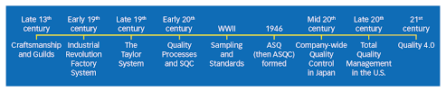
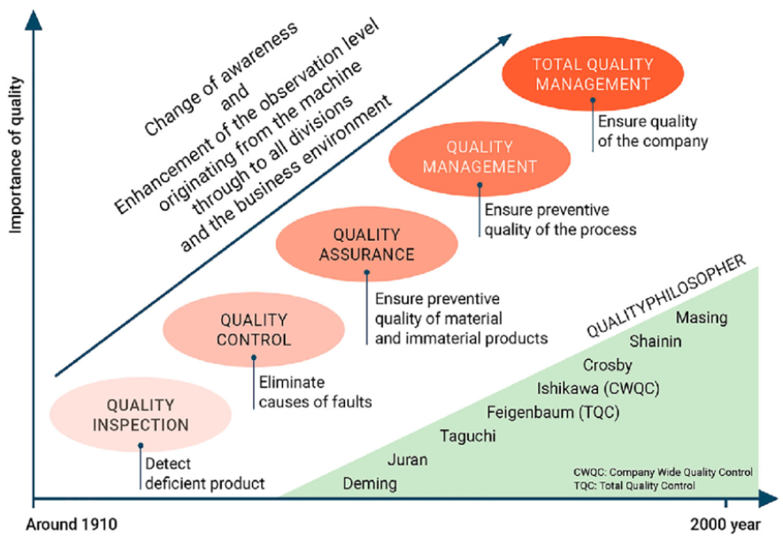
Quality – History
Ref: Four decades of research on quality: summarising, Trendspotting and looking ahead - Scientific Figure on ResearchGate. Available from: https://www.researchgate.net/figure/Depiction-of-QMs-historical-development-Weckenmann-et-al-2015_fig1_335290066 [accessed 8 Jul 2025]
Prof. Shreenivas Londhe and Dr. Preeti Kulkarni, Department of Civil Engineering, VIIT , Pune-48

Slide 13
Quality Management
ISO 9000:2015 : Quality management is coordinated activities to direct and control an organization with regard to quality.
This includes establishing a quality policy and quality objectives, and implementing quality planning, control, assurance, and improvement.
Quality management is how a company ensures that its products or services consistently meet customer expectations and comply with regulations.
Key Components of Quality Management:
Quality Planning – Defining quality standards and how to meet them.
Quality Assurance – Systematic activities to build confidence in product quality.
Quality Control – Operational techniques to meet quality requirements.
Quality Improvement – Ongoing efforts to improve products, services, or processes.
Prof. Shreenivas Londhe and Dr. Preeti Kulkarni, Department of Civil Engineering, VIIT , Pune-48

Slide 14
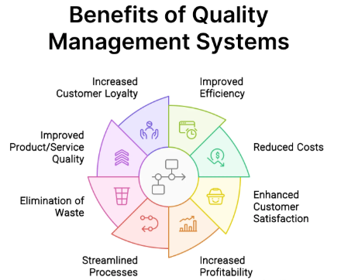
Quality – Benefits
Prof. Shreenivas Londhe and Dr. Preeti Kulkarni, Department of Civil Engineering, VIIT , Pune-48

Slide 15
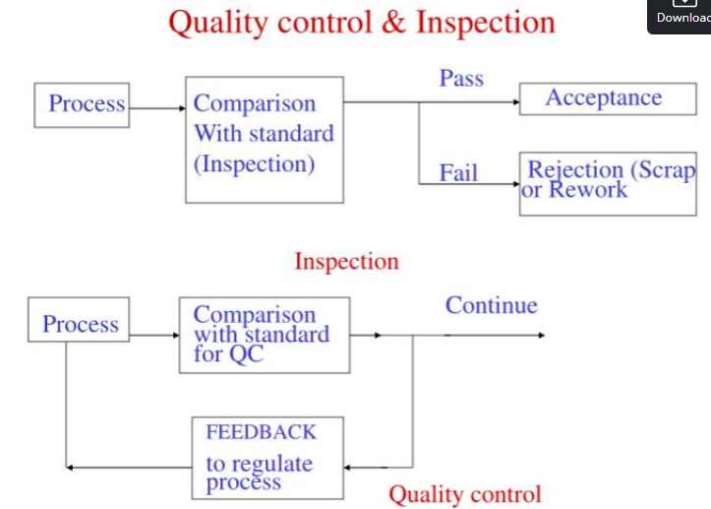
Quality Control
Quality Control is essentially the activities and techniques employed to achieve and maintain the quality of a product, process, or service.
It involves the monitoring activity, but also concerns finding and eliminating causes of quality problems so that requirements of customers are continuously met.
Prof. Shreenivas Londhe and Dr. Preeti Kulkarni, Department of Civil Engineering, VIIT , Pune-48

Slide 16
Quality Assurance
Quality assurance (QA) is any systematic process of determining whether a product or service meets specified requirements.
QA establishes and maintains set requirements for developing or manufacturing reliable products.
A quality assurance process is meant to increase customer confidence and a company's credibility while improving work processes and efficiency.
It also helps a company compete in its market.
The International Organization for Standardization (ISO) is a driving force behind QA practices and mapping the processes used to implement QA.
QA is often paired with the ISO 9000 international standard.
Many companies use ISO 9000 to ensure their QA system is in place and effective.
Prof. Shreenivas Londhe and Dr. Preeti Kulkarni, Department of Civil Engineering, VIIT , Pune-48

Slide 17
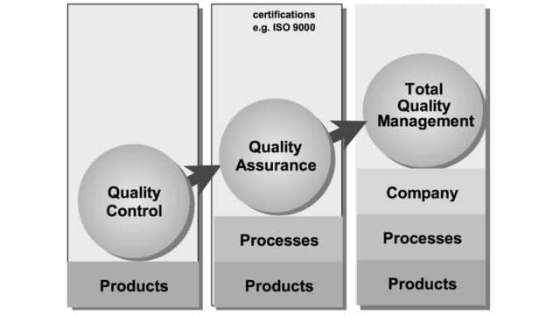
Quality – The journey
Prof. Shreenivas Londhe and Dr. Preeti Kulkarni, Department of Civil Engineering, VIIT , Pune-48

Slide 18
Total Quality Management
Total quality management (TQM) is the continual process of detecting and reducing or eliminating errors in manufacturing.
Total quality management aims to hold all parties involved in the production process accountable for the overall quality of the final product or service.
Total Quality Management (TQM) is also referred to as total productive maintenance.
It is the approach of the management to achieve long-term success by focusing on customer satisfaction.
The organization works towards a steady improvement in quality at all stages of production.
TQM also helps reduce risks in manufacturing, improve the customer experience, and ensure that the employees are well-versed and up-to-date with their training.
TQM is a comprehensive, organization-wide approach to improve quality continuously.
Involves all organizational processes and employees
Focuses on customer satisfaction, employee involvement, and process improvement.
Prof. Shreenivas Londhe and Dr. Preeti Kulkarni, Department of Civil Engineering, VIIT , Pune-48

Slide 19
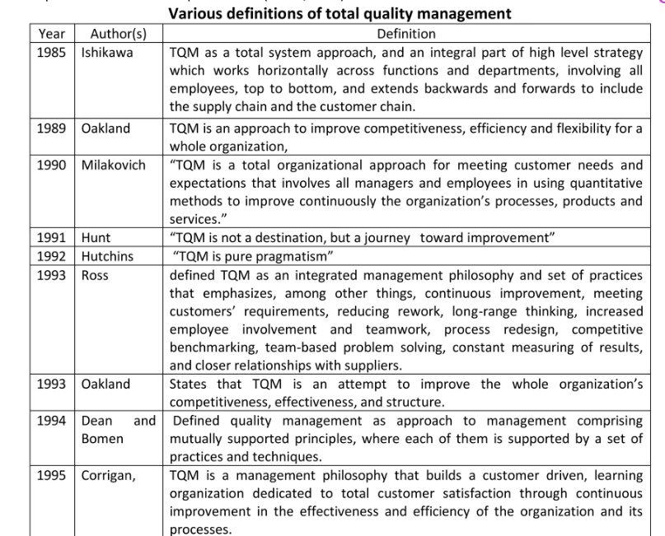
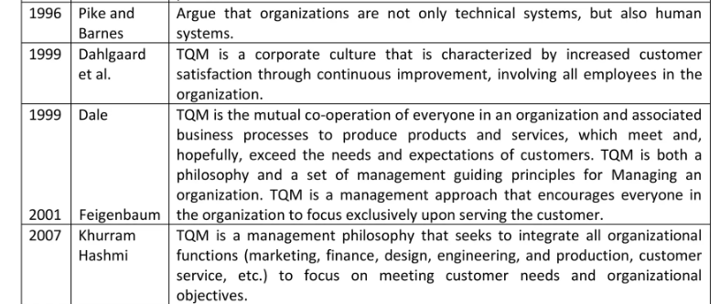
Total Quality Management – Definitions
Prof. Shreenivas Londhe and Dr. Preeti Kulkarni, Department of Civil Engineering, VIIT , Pune-48

Slide 20
Total Quality Management – History
Frederick W. Taylor wrote Principles of Scientific Management in 1911.
Walter A. Shewhart used statistics in quality control and inspection, and showed that productivity improves when variation is reduced (1924); wrote Economic Control of Manufactured Product in 1931.
W. Edwards Deming and Joseph M. Juran, students of Shewhart, went to Japan in 1950; began the transformation from “shoddy” to “world-class” goods.
In 1960, Dr. K. Ishikawa formalized quality circles — the use of small groups to eliminate variation and improve processes.
In the late 1970s and early 1980s:
Deming returned from Japan to write Out of the Crisis, and began his famous 4-day seminars in the United States.
Phil Crosby wrote Quality is Free.
NBC ran the documentary “If Japan can do it, why can’t we?”
Motorola began Six Sigma.
Prof. Shreenivas Londhe and Dr. Preeti Kulkarni, Department of Civil Engineering, VIIT , Pune-48

Slide 21
Total Quality Management – History
TQM can be defined as a total commitment to the continuous improvement of a company's processes in order to maximize assets, reduce waste and rework, and satisfy and retain customers.
TQM is an endless process of continual improvement. This management system was co-developed by W. Edwards Deming and Joseph Juran.
In adopting Deming's 14 basic principles (points) in their company, managers will need to stop depending on inspections to achieve quality; create a constancy of purpose to improve service; make quality the ultimate measure of success; stop awarding business solely on price; constantly improve service systems; adopt training programs; provide leadership; drive out fear; break down barriers among staff areas; eliminate slogans and targets; eliminate numerical goals; remove barriers to employees' pride in their work; institute a program for retraining and education; and take action.
Prof. Shreenivas Londhe and Dr. Preeti Kulkarni, Department of Civil Engineering, VIIT , Pune-48

Slide 22
Deming’s 14 points
Create constancy of purpose for improvement
Adopt a new philosophy
Cease dependence on mass inspection
Do not award business on price alone
Work continually on the system of production and service
Institute modern methods of training
Institute modern methods of supervision of workers
Drive out fear
Break down barriers between departments
Eliminate slogans, exhortations, and targets for the workforce
Eliminate numerical quotas
Remove barriers preventing pride of workmanship
Institute a vigorous program of education and retraining
Take action to accomplish the transformation
Prof. Shreenivas Londhe and Dr. Preeti Kulkarni, Department of Civil Engineering, VIIT , Pune-48

Slide 23
Deming’s points
Understanding (and appreciation) of Systems :
Optimizing sub-systems sub-optimizes the total system
The majority of defects come from systems, which are the responsibility of management (e.g., machines not in good order, defective material, etc.)
Knowledge of Statistics (variation, capability, uncertainty in data, etc.)
Used to identify where problems are and to guide managers and workers toward solutions
Knowledge of Psychology (Motivation)
People are afraid of failing and not being recognized,
So they fear how data will be used against them
Theory of Knowledge
Understanding that management in any form is a prediction, and is based on assumptions
Prof. Shreenivas Londhe and Dr. Preeti Kulkarni, Department of Civil Engineering, VIIT , Pune-48

Slide 24
According to Dr. Joseph M. Juran (1991):
“On the assembly line at the Ford Motor Company in 1923, most of the workers producing Model T’s were immigrants and could not speak English. Many were also illiterate. Workers learned their trade by modeling the actions of other workers. They were unable to plan, problem-solve, and make decisions. As a result, the Taylor scientific school of management flourished, and MBAs and industrial engineers were invented to do this work.
Today, however, the workforce is educated. Workers know what is needed to improve their jobs, and companies that do not tap into this significant source of knowledge will truly be at a competitive disadvantage.”
According to Phil Crosby, Quality is...
An attitude:
Zero Defects
Continuous Improvement
A measurement:
Price of Conformance, plus
Price of Nonconformance (defects)
Prof. Shreenivas Londhe and Dr. Preeti Kulkarni, Department of Civil Engineering, VIIT , Pune-48

Slide 25
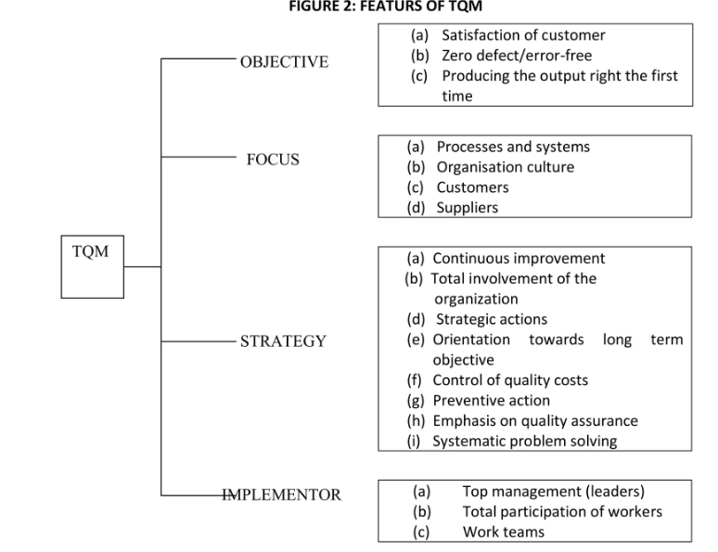
Features of TQM
Prof. Shreenivas Londhe and Dr. Preeti Kulkarni, Department of Civil Engineering, VIIT , Pune-48

Slide 26
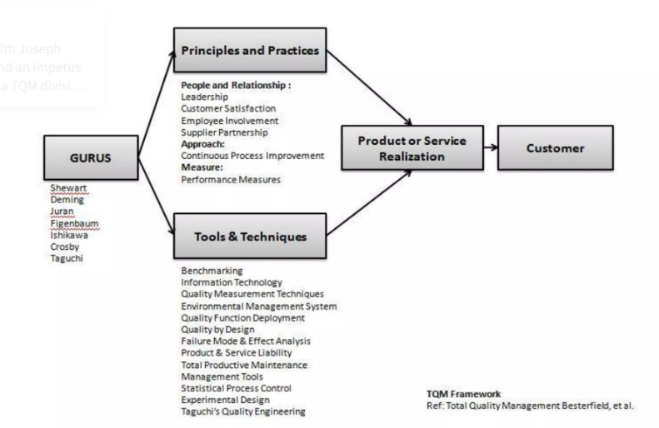
TQM framework
Prof. Shreenivas Londhe and Dr. Preeti Kulkarni, Department of Civil Engineering, VIIT , Pune-48

Slide 27
Transformation in Quality Thinking
From | To
Motivation through fear and loyalty | Motivation through shared vision
Attitude: “It’s their problem” | Ownership of every problem affecting the customer
Attitude: “the way we’ve always done it” | Continuous improvement
Decisions based on assumptions/judgment calls | Decisions based on data and facts
Everything begins and ends with management | Everything begins and ends with customers
Crisis management and recovery | Doing it right the first time
Choosing participative OR scientific management | Choosing scientific AND participative management
Prof. Shreenivas Londhe and Dr. Preeti Kulkarni, Department of Civil Engineering, VIIT , Pune-48

Slide 28
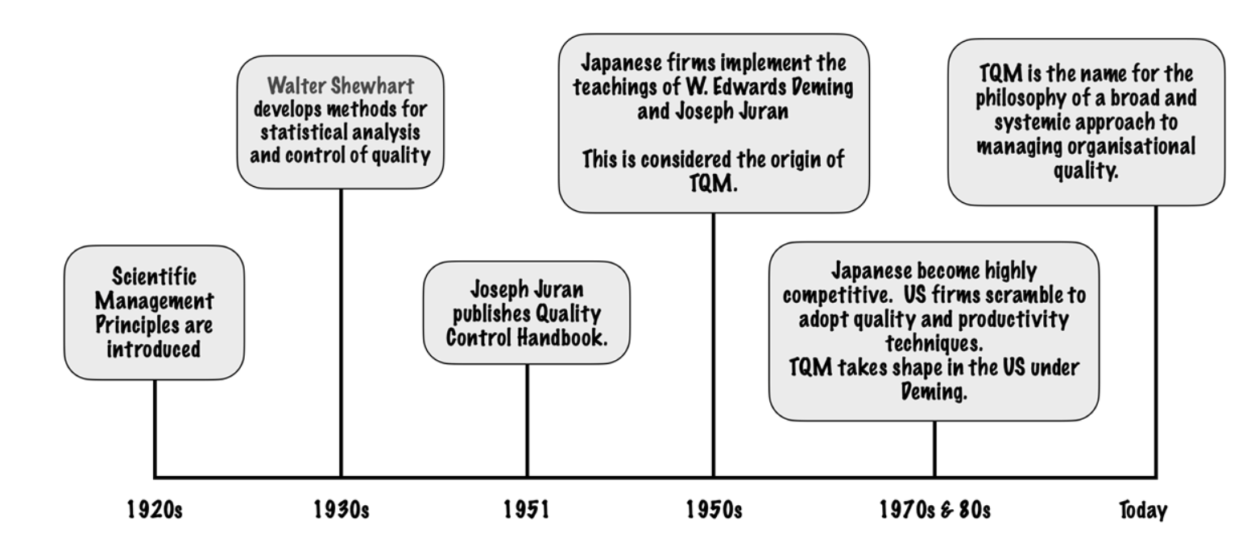
Total Quality Management History-In a nutshell
Prof. Shreenivas Londhe and Dr. Preeti Kulkarni, Department of Civil Engineering, VIIT , Pune-48

Slide 29
Total Quality Management – Way ahead
As the 21st century begins, the quality movement has matured and goes beyond Deming, Juran, and the early Japanese practitioners of quality. E.g:
In2015, the ISO 9001 standard was revised to increase emphasis on risk management.
In 2000, the ISO 9000 series of quality management standards was revised to increase emphasis on customer satisfaction.
Beginning in 1995, the Malcolm Baldrige National Quality Award added a business results criterion to its measures of applicant success.
Six Sigma, a methodology developed by Motorola to improve its business processes by minimizing defects, evolved into an organizational approach that achieved breakthroughs and significant bottom-line results.
Quality function deployment was developed by Dr. Yoji Akao as a process for focusing on customer wants or needs in the design or redesign of a product or service.
Sector-specific versions of the ISO 9000 series of quality management standards were developed for such industries as automotive (QS-9000 and ISO/TS 16949), aerospace (AS9000) and telecommunications (TL 9000) and for environmental management (ISO 14000).
Quality has moved beyond the manufacturing sector into such areas as service, healthcare, education, and government.
The Malcolm Baldrige National Quality Award has added education and healthcare to its original categories: manufacturing, small business, and service. Many advocates are pressing for the adoption of a "nonprofit organization" category as well.
Prof. Shreenivas Londhe and Dr. Preeti Kulkarni, Department of Civil Engineering, VIIT , Pune-48

Slide 30
Wrap up and related outcomes
Understand concept of quality, Total Quality Management (TQM
Discuss history and principles of Quality
Prof. Shreenivas Londhe and Dr. Preeti Kulkarni, Department of Civil Engineering, VIIT , Pune-48

Slide 31
To be discussed next time
TQM Principles and TQM Tools
Prof. Shreenivas Londhe, Department of Civil Engineering, VIIT , Pune-48
Faculty Name(optional), Department of ______Engineering, VIIT, Pune-48

Slide 32
Thank You
Prof. Shreenivas Londhe and Dr. Preeti Kulkarni, Department of Civil Engineering, VIIT , Pune-48

